Slide 1
Unmanned Aerial Vehicle
(UAV)
Course Code : MCTE 4362
Lecturer : Dr. Zulkifli bin Zainal Abidin
Slide by : Muhammad Iqmal Danish bin Hasnan (1912461)

Slide 2
History of UAV Robot
This presentation provides an overview of the history of UAV robots, from their early development for training purposes in World War I to their use in military, civilian, and commercial settings today.

Slide 3
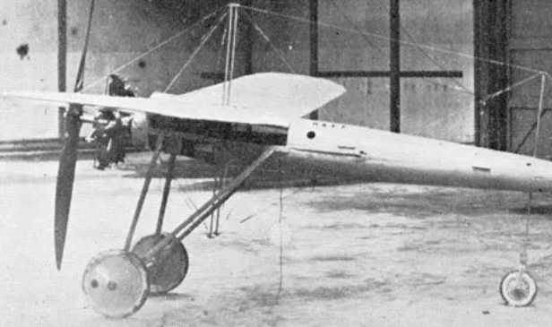
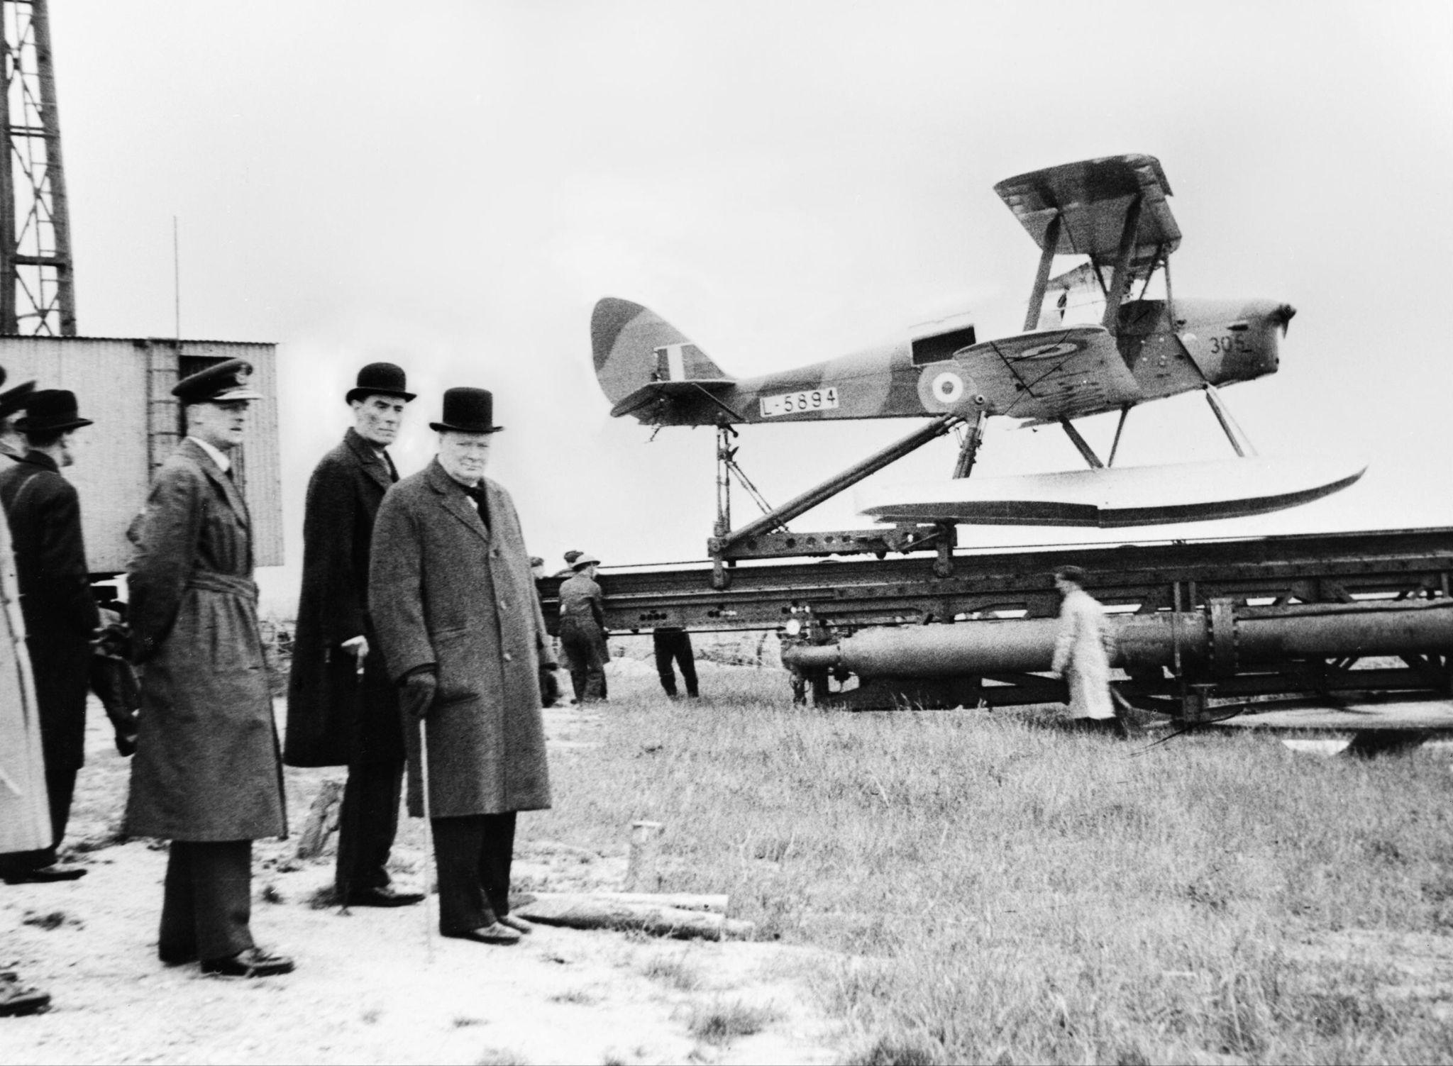
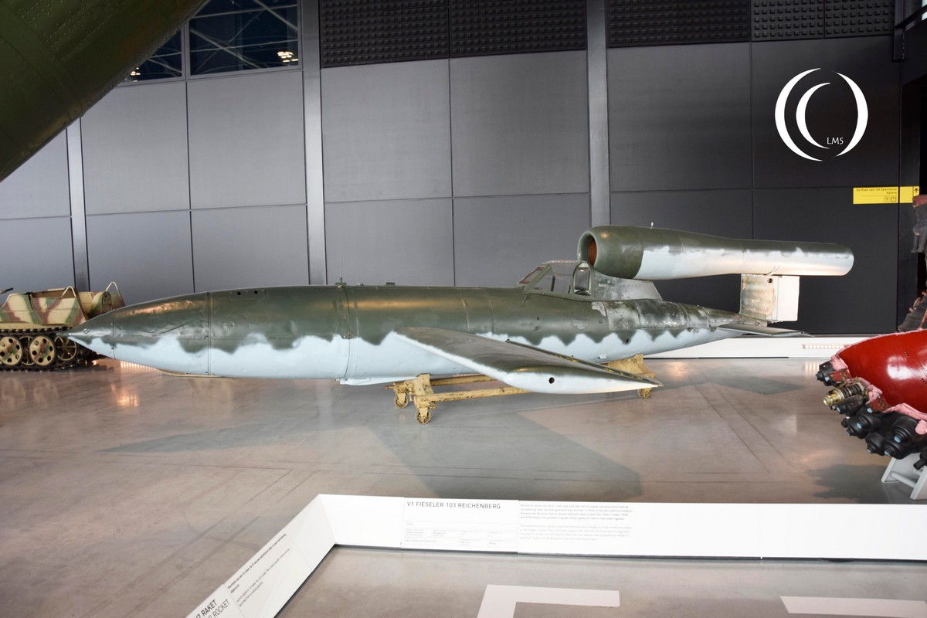
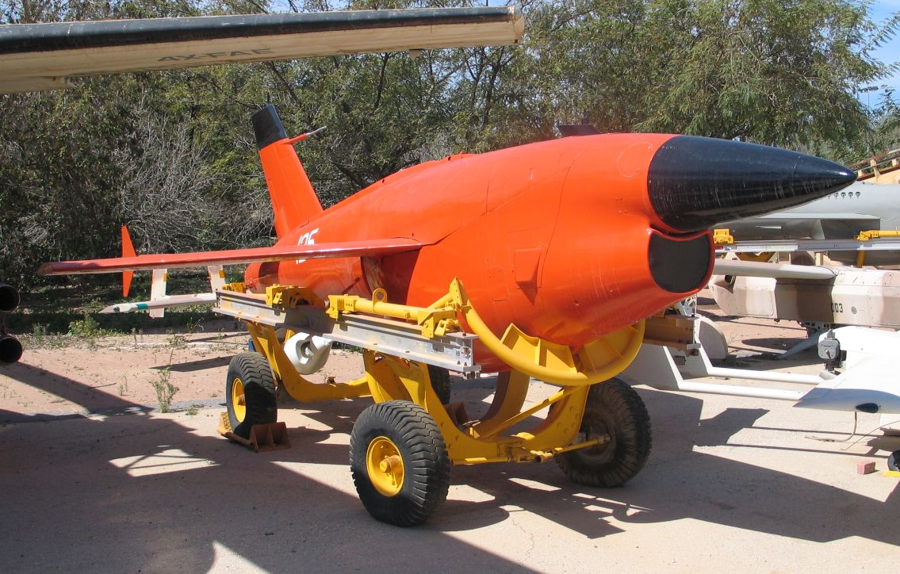
Early Developments (1916-1950s)
The first remotely controlled unmanned aircraft was developed by Archibald Low in 1916.
The British developed the first radio-controlled aircraft, called the "Queen Bee," in 1935.
The Germans developed the first unmanned combat aircraft, called the "Fieseler Fi 103R," during World War II.
The United States Air Force developed the "Ryan Firebee" for reconnaissance and surveillance.
First UAV
Queen Bee
Fieseler Fi 103R
Ryan Firebee

Slide 4
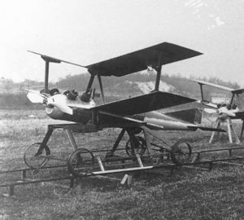
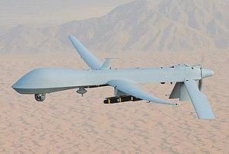
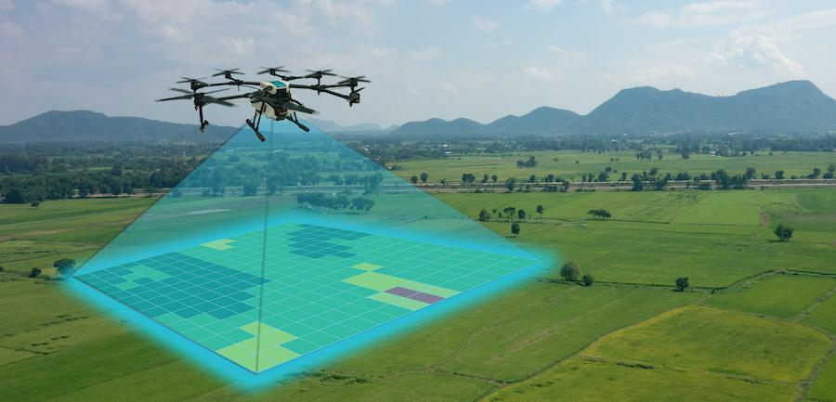
Advancements (1960s-1990s)
The United States Navy developed the "Kettering Bug" for target practice.
The United States military developed the "Predator" for unmanned aerial reconnaissance and surveillance in the 1980s.
In the 1990s, UAVs began to be used for civilian applications like aerial photography and mapping.
Kettering Bug
Predator
Aerial mapping

Slide 5
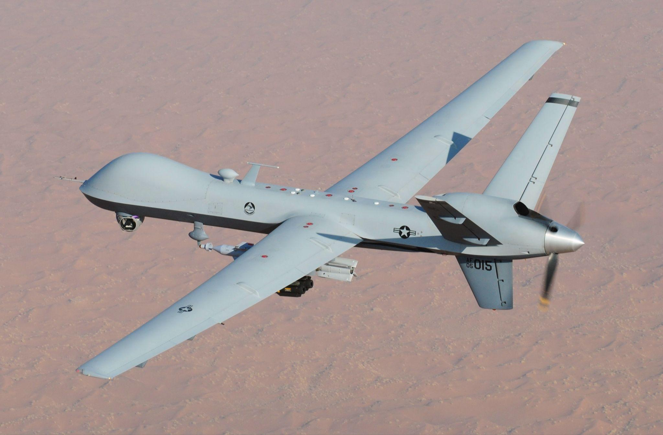
Military Applications (2000s)
The United States military began to use armed UAVs for combat operations in the early 2000s, including the "Predator" and "Reaper" drones.
UAVs provided new capabilities for intelligence gathering, surveillance, and precise targeting in military operations.
Reaper

Slide 6
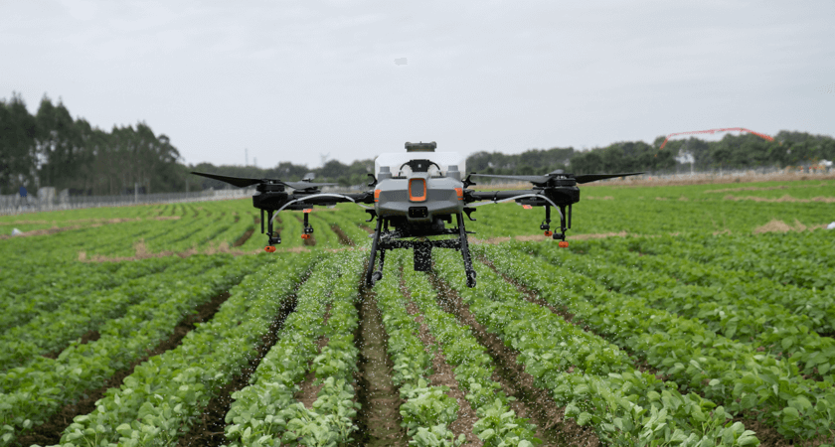
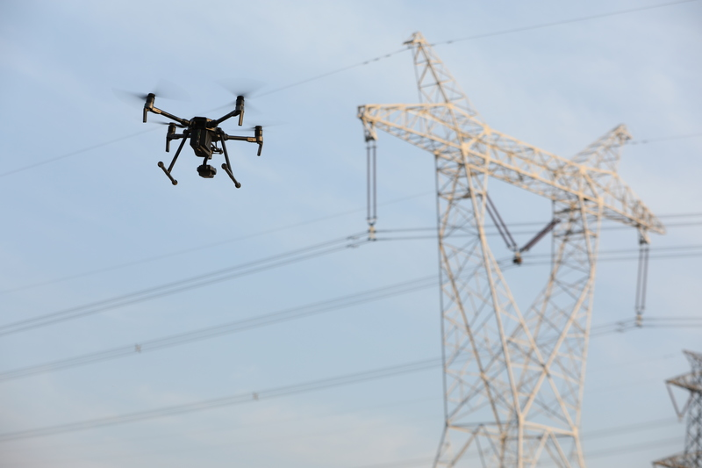
Commercial Applications (2010s)
UAV technology continued to advance, with a wide range of applications in military, civilian, and commercial settings.
UAVs are used for tasks like monitoring crops, inspecting power lines and pipelines, and conducting search and rescue operations.
Agras T10
DJI M200

Slide 7
Main Components of the Vehicle
Hull Design
Navigation System and Control
Data Transmission
Propulsion System
Data Collection
Power Management

Slide 8
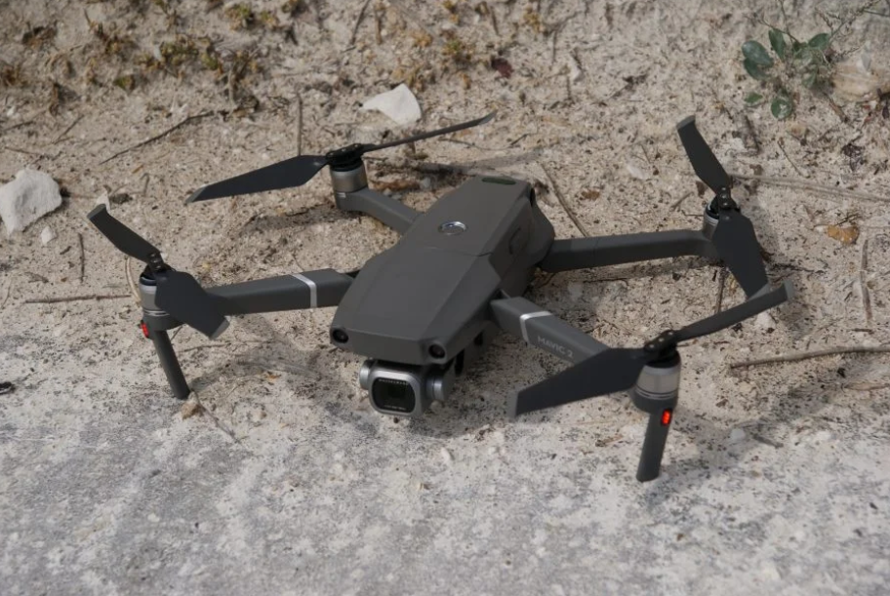
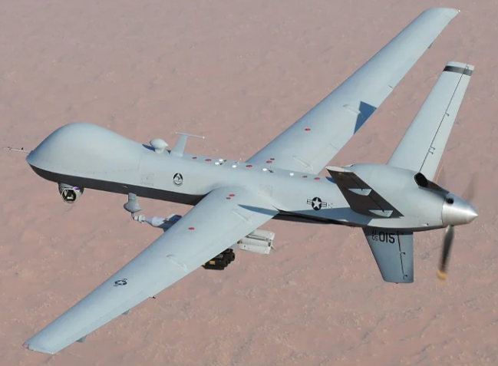
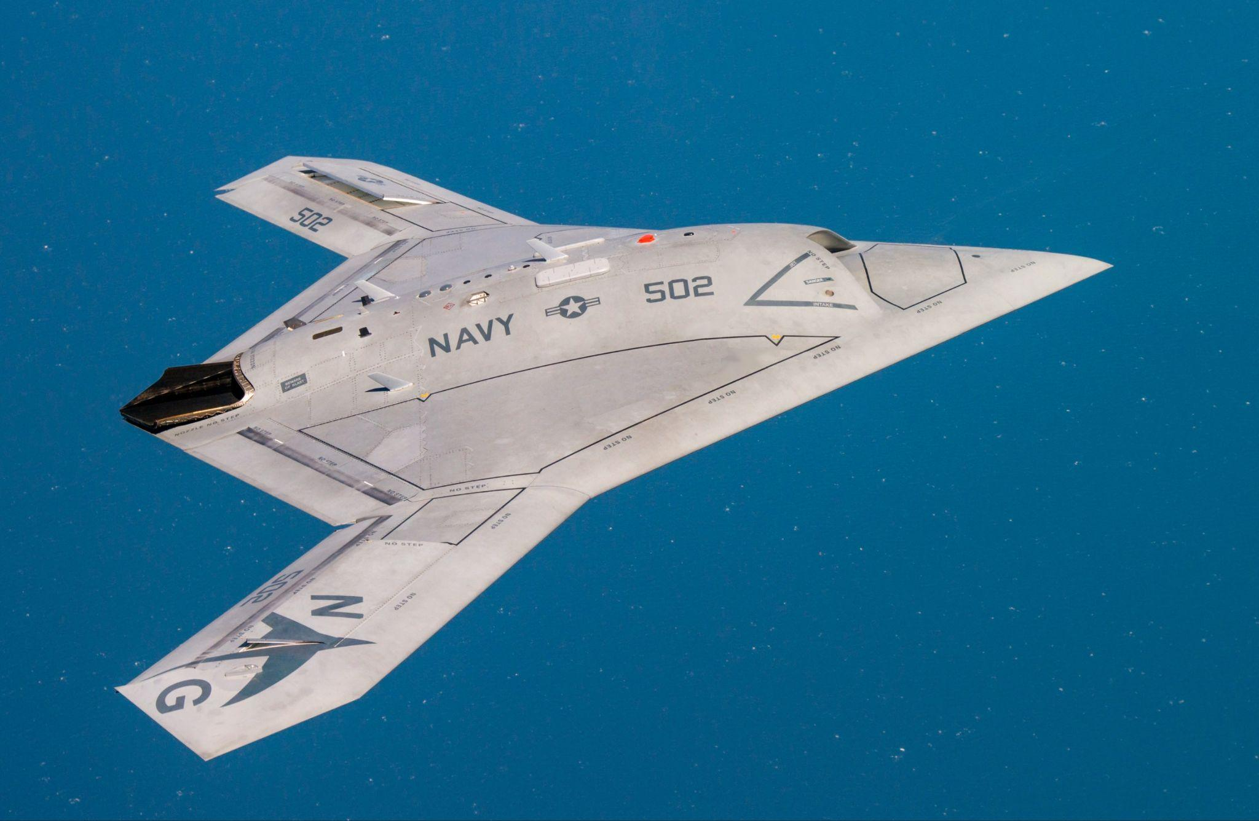
Hull Design
DJI Mavic 2 Pro
General Atomics MQ-1 Predator
Northrop Grumman X-47B
Monocoque Hull Design
Tube-and-Wing Hull Design
Blended Wing

Slide 9
Hull Design
Type | Monocoque Hull Design | Tube-and-Wing Hull Design | Blended Wing
Explanation | Lightweight and strong structure Made of composite materials such as carbon fiber or Kevlar | Consists of a central tube or fuselage that houses the payload and wings or rotors that attach to the tube. | A hybrid between a fixed-wing and rotorcraft UAV Features a wide and flat fuselage with wings or rotors that are blended into the body
Advantages | Light and efficient Provides good protection against the weather. | Versatile and stable Easy to manufacture and repair | Efficient Providing a high lift-to-drag ratio, which increases its range and payload capacity
Disadvantages | Expensive to manufacture and repair May not be as durable as other hull designs | Heavy Susceptible to wind and other environmental factors | Complex and expensive to manufacture Difficult to maintain and repair
Applications | Surveillance, reconnaissance, and mapping | Military and commercial UAVs | Military and commercial UAVs
Model | DJI Mavic 2 Pro | General Atomics MQ-1 Predator | Northrop Grumman X-47B

Slide 10
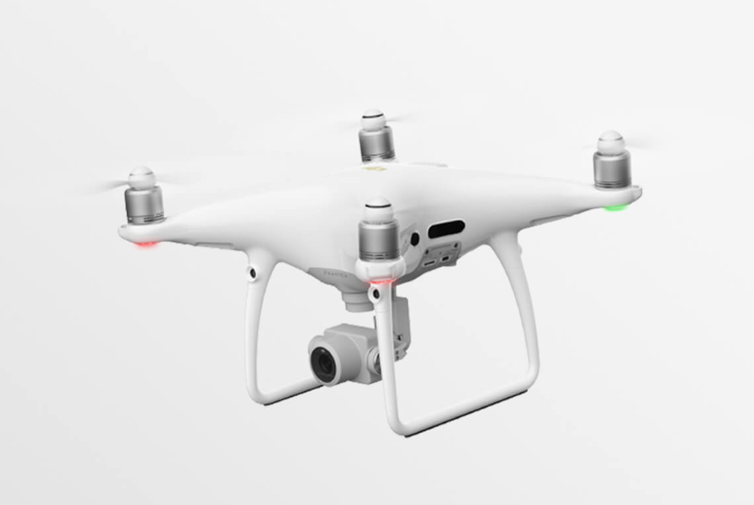
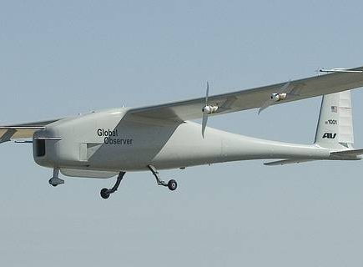
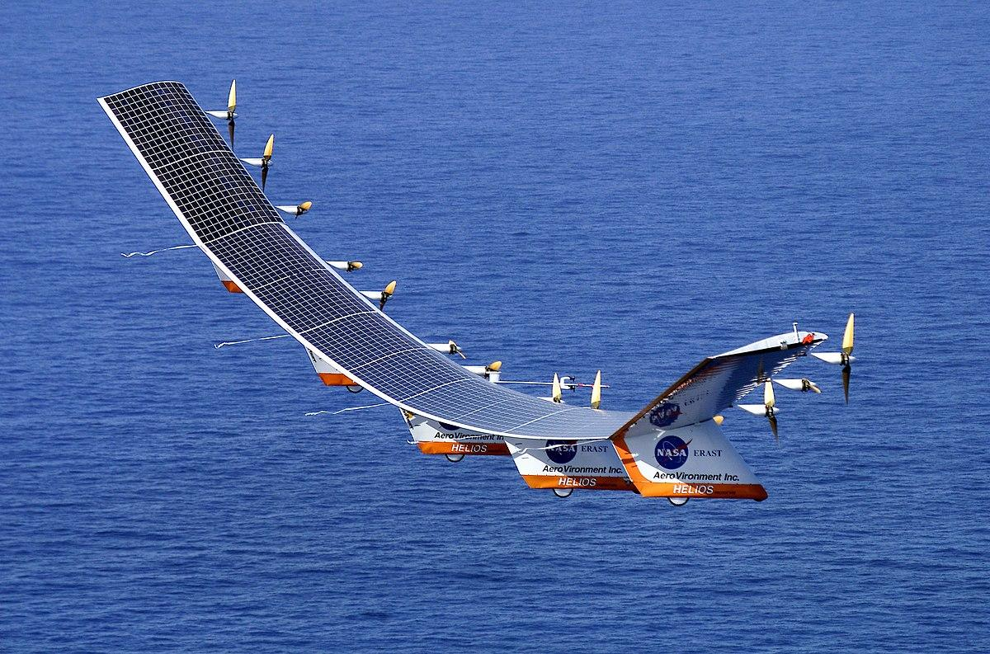
Propulsion System
DJI Phantom 4 Pro
AeroVironment Global Observer
NASA Helios UAV
Electric Propulsion System
Jet Propulsion System
Solar Propulsion System

Slide 11
Propulsion System
Type | Electric Propulsion System | Jet Propulsion System | Solar Propulsion System
Explanation | Uses electric motors to generate thrust Powered by batteries or fuel cells | Uses a combination of air intake and combustion to generate high-speed thrust Typically used in high-speed, high-altitude UAVs | Uses photovoltaic cells to generate electricity Powers the onboard systems and motors
Advantages | Quiet and efficient Produce no emissions | High speed and altitude capabilities Longer range and faster flight times. | Long flight times and the ability to operate continuously in daylight, with no need for recharging or refueling
Disadvantages | Limited flight time due to battery capacity, and the need for recharging | High fuel consumption High noise levels | Limited flight times at night or in low-light conditions Reduced performance in cloudy weather
Applications | Mapping, surveying, and environmental monitoring | Military and defense, atmospheric research, and meteorological studies. | Climate research, remote sensing, and long-term environmental monitoring.
Model | DJI Phantom 4 Pro | AeroVironment Global Observer | NASA Helios UAV

Slide 12
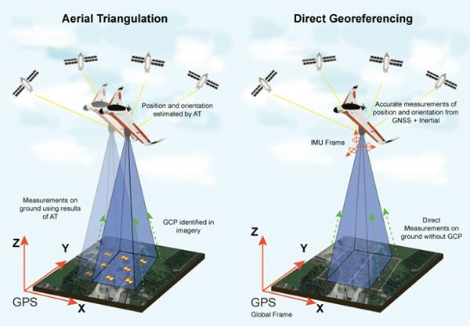
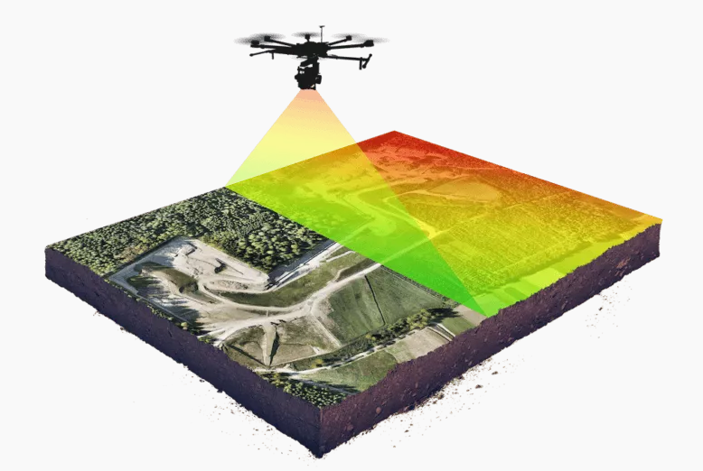
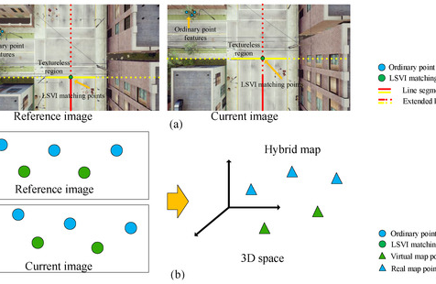
Navigation System & Control
Inertial Navigation System (INS)
LiDAR
Visual Odometry (VO)

Slide 13
Navigation System & Control
Type | Inertial Navigation System (INS) | LiDAR | Visual Odometry (VO)
Explanation | Measures the vehicle's acceleration and angular rate to determine its position and velocity relative to its starting point. | Uses lasers to generate high-resolution 3D maps of the environment Allowing for accurate position and obstacle detection | Uses visual images from cameras mounted on the UAV Estimate the vehicle's motion and position
Advantages | Not dependent on external signals Reliable in GPS-denied environments | Provides highly accurate 3D maps of the environment Can be used in low-light or GPS-denied environments | Provides high-accuracy position and velocity estimates Can be used in GPS-denied environments
Disadvantages | Accumulates errors over time, leading to position drift Requires initial calibration and periodic updates to maintain accuracy | Expensive Requires high-power consumption Can be affected by weather conditions | Requires high-quality cameras and processing power Sensitive to lighting and environmental conditions
Applications | Autonomous navigation and avionics systems for aircraft navigation | Autonomous navigation, surveying, mapping, and other geospatial applications | Autonomous navigation,robotics and augmented reality applications
Model | DJI Matrice 600 Pro | DJI M600 Pro RTK | DJI Mavic 2 Pro

Slide 14
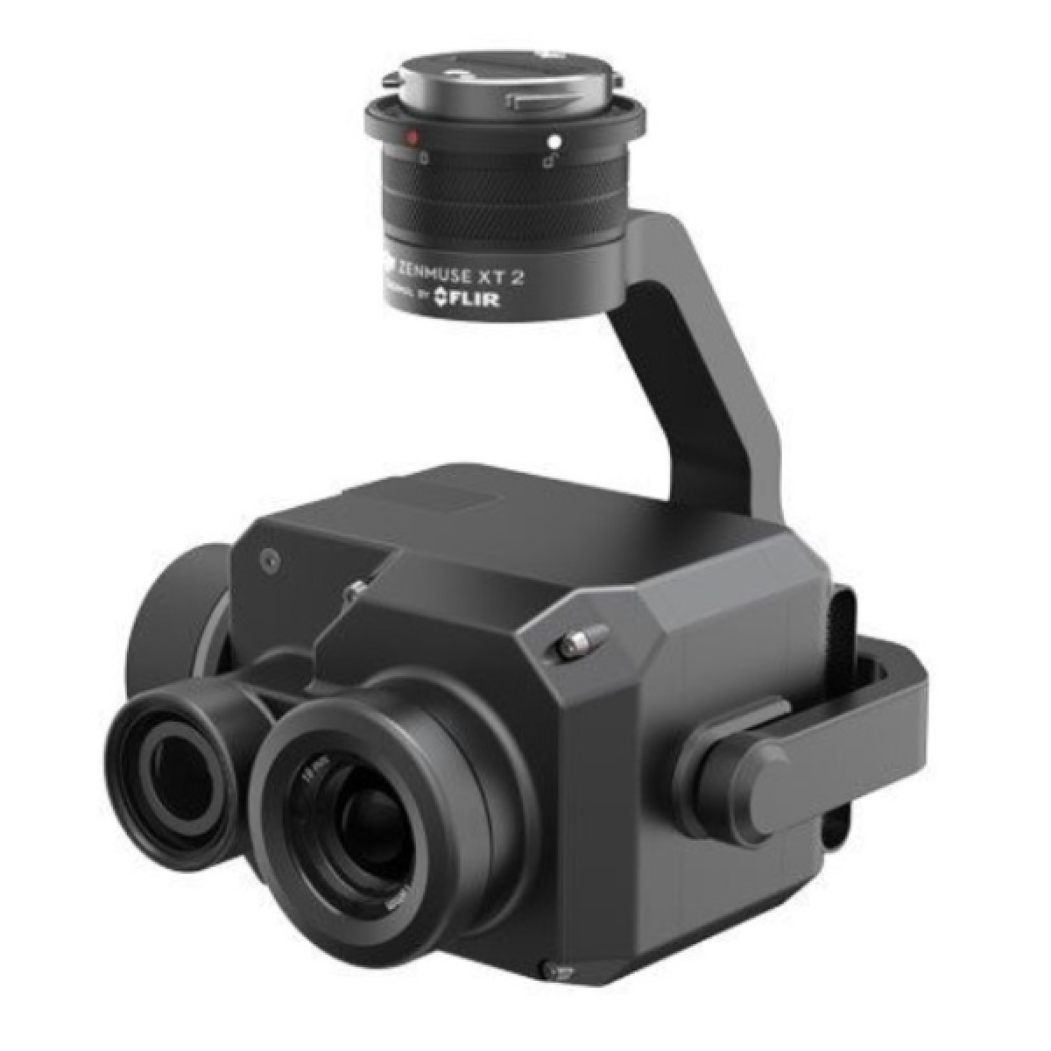
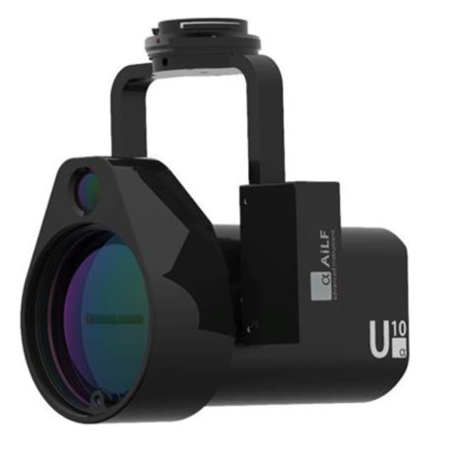
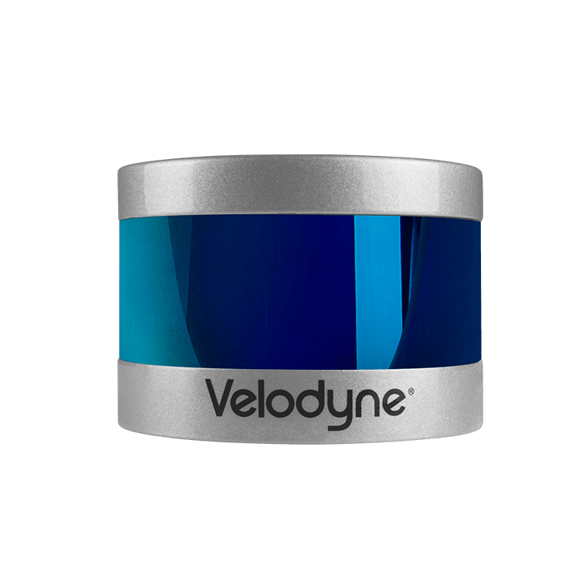
Data Collection (Payload)
Velodyne VLP-16 LiDAR Sensor
DJI Zenmuse XT2
AILF U10 Gas Sensor

Slide 15
Data Collection (Payload)
Type | LiDAR (Light Detection and Ranging) | Thermal Imaging | Gas and Chemical Sensors
Explanation | Uses laser pulses to measure distances between the drone and the ground, buildings, and other objects The data is then used to create 3D models or maps | Captures heat signatures from objects and areas using an infrared camera The data is then used to create heat maps or detect temperature differences | Used to detect and measure the presence of various gases and chemicals in the air
Advantages | High accuracy and precision Capture data even in low light conditions Can penetrate vegetation | Can detect temperature differences in hard-to-reach areas Can be used in low light conditions Can detect potential fire hazards | Can detect harmful gases and chemicals Can be used in hazardous environments Can monitor air quality
Disadvantages | Expensive equipment Limited range Requires specialized training | Limited accuracy Affected by weather conditions Requires specialized training | Limited range Requires specialized training Can be affected by weather conditions
Applications | Forestry, agriculture, and archaeology | Search and rescue, building inspections, and agriculture | Environmental monitoring, emergency response, and public safety
Model | Velodyne VLP-16 LiDAR Sensor | DJI Zenmuse XT2 | AILF U10 Gas Sensor

Slide 16
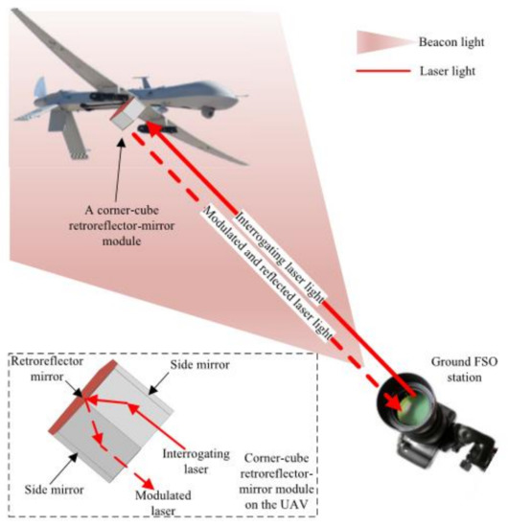
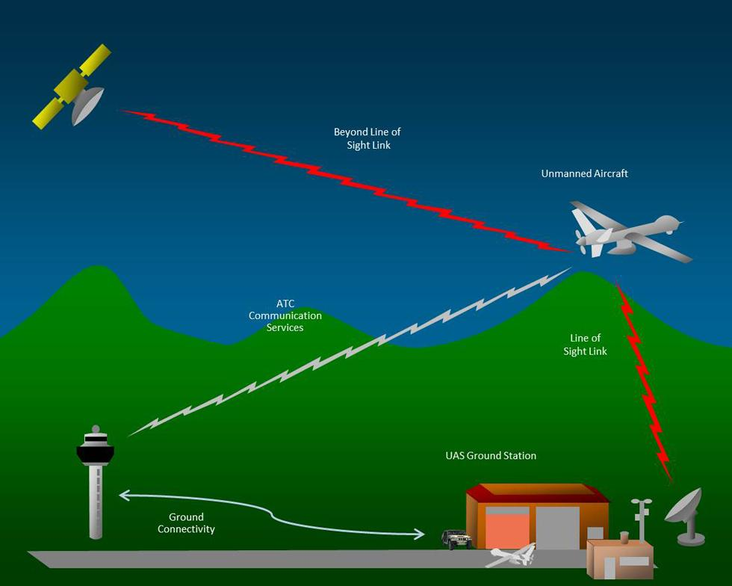
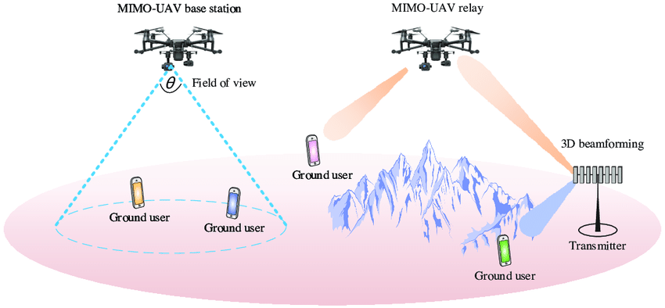
Data Transmission (Communication)
Wireless Transmission
Optical Transmission
Satellite Transmission

Slide 17
Data Transmission (Communication)
Type | Wireless Transmission | Optical Transmission | Satellite Transmission
Explanation | Transfer of data over radio waves, typically using Wi-Fi, Bluetooth, or cellular networks. | Uses light waves to transfer data, typically through fiber optic cables | Uses communication satellites to transfer data between devices on the ground or in the air
Advantages | Convenient Easy to use | Fast and secure Can cover large distances | Reliable Can cover large distance
Disadvantages | Slower Can be less reliable than wired transmission | Expensive Requires specialized equipment | Expensive Requires specialized equipment
Applications | Transmit images and video captured by the drone's camera to a smartphone or tablet | Transmit high-definition video and images captured by the drone's camera to the remote operator or pilot | Transmit data and images to ground stations from remote locations
Model | DJI Mavic Air 2 | Parrot Anafi USA | Insitu ScanEagle

Slide 18
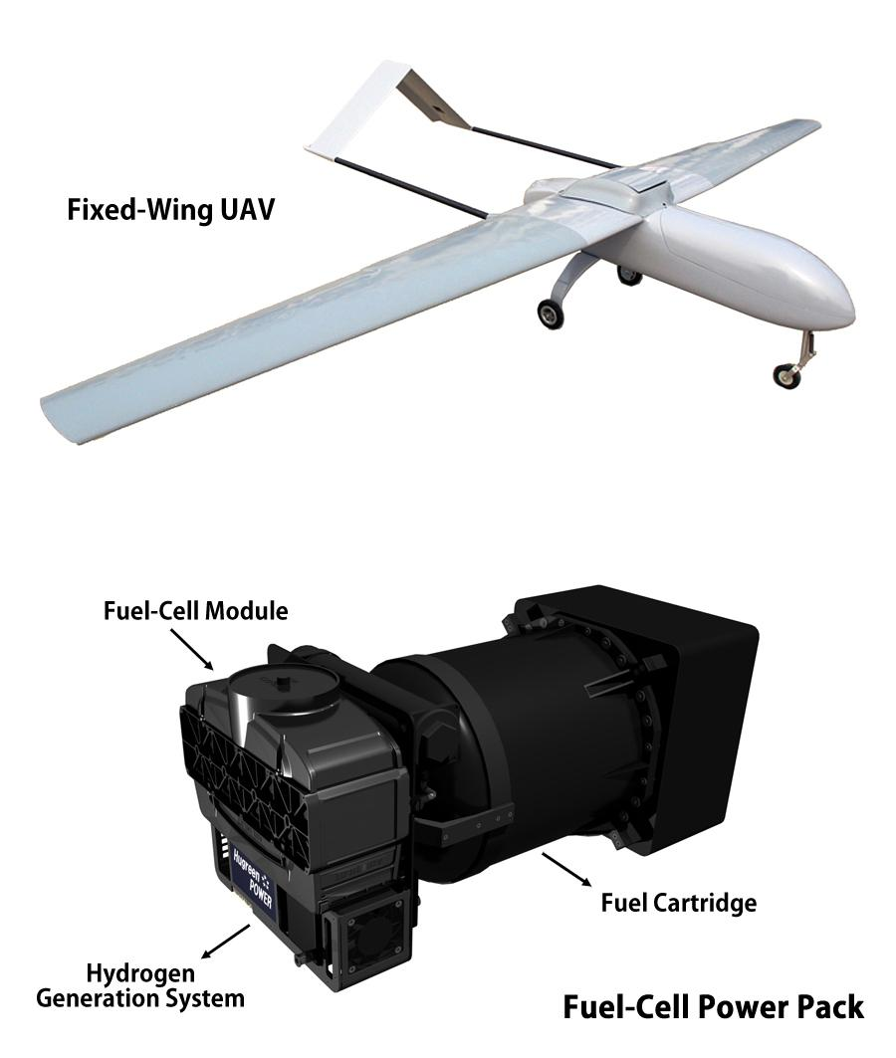
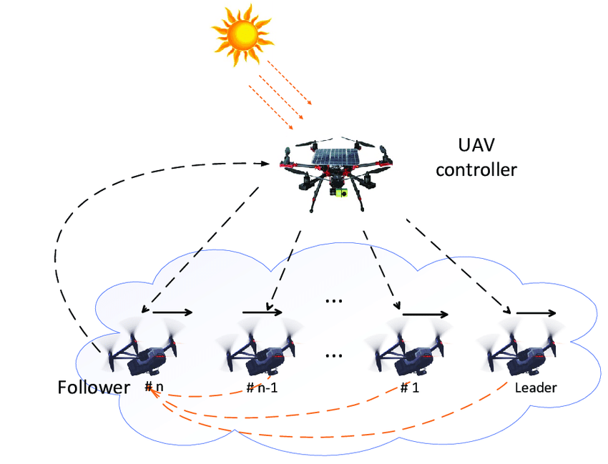
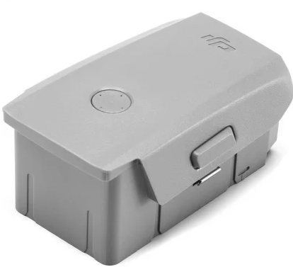
Power Management
Energy Harvesting
Battery Power
(Lithium Ion Polymer Rechargeable Battery)
Fuel Cell Power

Slide 19
Power Management
Type | Energy Harvesting | Battery Power | Fuel Cell Power
Explanation | Process of capturing and storing energy such as solar power, wind power, and kinetic energy from the environment to power a UAV robot | The batteries store chemical energy that is converted into electrical energy to power the drone's motors and other components | Using a fuel cell to convert hydrogen or other fuels into electricity to power the drone's motors and other components
Advantages | Reduces the need for external power sources Saves costs on batteries Increases the UAV robot's flight time | Easily rechargeable and can be swapped out for new batteries quickly A clean source of energy that doesn't produce emissions or require any fueling infrastructure | Provide longer flight times and greater range compared to battery power Generates only water and heat as byproducts, making it a very clean energy source
Disadvantages | Relies on the availability of energy sources May not be suitable for all environments | Limited range and flight time Batteries can be heavy, which can impact the drone's payload capacity and overall performance | Can be expensive and require specialized infrastructure for refueling Fuel cells are heavy
Applications | Environmental monitoring, agriculture, and search and rescue | Aerial photography, surveillance, and inspection tasks | Transmit data and images to ground stations from remote locations
Model | AeroVironment Puma AE | DJI Mavic Air 2 | Protonex UAV

Slide 20
Thank you for your time 😊

